Slide 1
IPCSA
“Port Community Systems supporting International Trade for SME’s”
Richard Morton
Secretary General
International Port Community Systems Association
28th June 2016
Winner Ambassador Hotel, Jinjiang,
Fujian Province, China

Slide 2
Challenges for SME’s in cross Border Trade
Potentially lack expertise in Trading across borders
Limited knowledge administrative processes, requirements and regulations
Rely on third parties for transportation of goods and for dealing with processes
Can have limited Access to appropriate infrastructure – internet etc. as well as expertise in it

Slide 3
The rise of Community Systems
Neutral Electronic Exchange platform
Community led trade facilitation tool
Trusted Third party (stakeholders from the community)
Relatively low development cost and operating costs
Low cost solution for users
Can be at all levels
Provide an interface between trade and administrative procedures
A community solution created by Information technology
Not a Software solution…….

Slide 4
PCS as Gateways for SME’s
Provide a trusted third party, community based, system
Link both the operational and administrative processes in the Logistics Chain
Support the third parties that SME’s rely on for transport of goods
SME’s who provide cross border trade transport services have simplified procedures
Many PCS are SME’s

Slide 5
What is a Port Community System ?
“A Port Community System is not an IT project, but a change management project.”
Javier Gallardo, Portic (IPCSA), Red VUCE meeting,
4th December, Cusco, Peru
A Port Community System is:
a neutral and open electronic platform enabling intelligent and secure exchange of information between public and private stakeholders in order to improve the competitive position of the sea and air ports’ communities.
optimises, manages and automates port and logistics efficient processes through a single submission of data and
connecting transport and logistics chains.
A TRUSTED THIRD PARTY

Slide 6
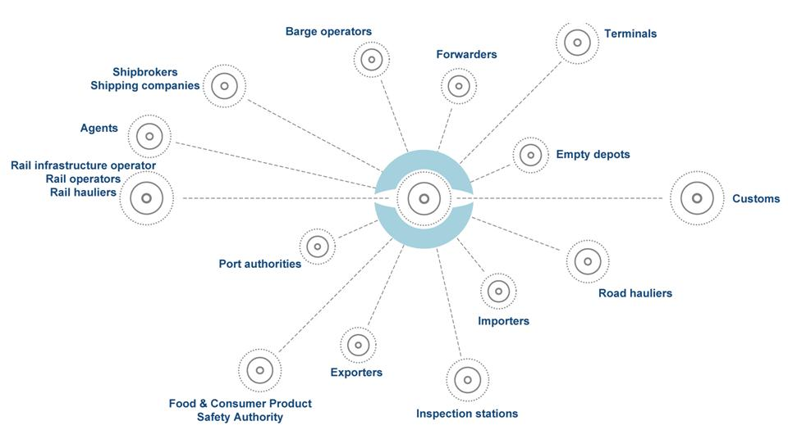
The Port Community System –
a typical example
PCS
PCS link Administrative and Operational procedures electronically via the exchange of messages on a end to end basis (machine to machine) with all stakeholders.

Slide 7
Types of PCS Services

Slide 8
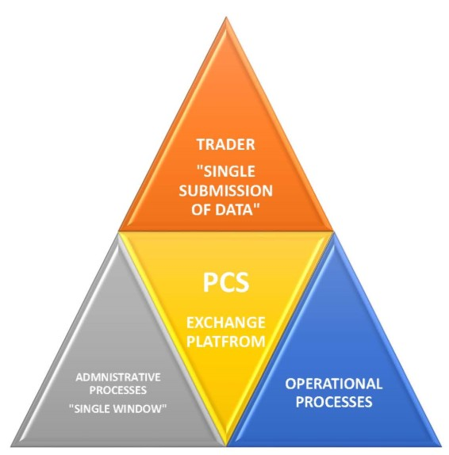
PCS – A Trade Facilitation Tool
A PCS:
Links administrative processes to operational ones
Thus re-using data for both purposes and the re-use of existing Information Systems
Creating Transparency & reducing trade burdens
Can also act as a Gateway into a Single Window
PCS thus link Administrative and Operational procedures electronically via the exchange of messages on a end to end basis (machine to machine) with all stakeholders.

Slide 9
Role of Port Community Systems
Gateways into Maritime Single Windows ( EU Directive 201/65 Ships Reporting Formalities)
PCS provide limited changes for operators
Reduce number of interfaces into government MSW or other agencies
Combines operations and administrative procedures
Trusted Third Party
Globalisation
Ports are global players
PCS are linking (through the IPCSA Track and Trace Initiative) ports across the world
Sharing data on vessels and consignments/containers
Multimodal Logistics Chains
PCS provide for seamless transmission of information between different parties in multimodal transport chain

Slide 10
Emerging Trends
Confused Trade Facilitation measures in different countries
Multiple Single Windows
Customs Single Window
Maritime Single Window
Veterinary Single Window
Trade Single Window with Port Community System
Single Invoice e.g vessel birthing fees, handling fees, duties, taxes etc. in one invoice
Benin, Togo

Slide 11
Question: How can SME’s benefit from Trade Faciliation Measures ?
Highlight to the SME representative bodies in Member States.
Better communication and should be more on practical benefits, including examples, as opposed to high level policy.
Increase in Community Systems
Engaged through third parties
Improved information infrastructure

Slide 12
“Port Community Systems and other private / public collaborative systems are the way forward and need to be incorporated into future methods of border management.”
Dr Alan Bersins, Assistant Secretary, US Department for Homeland Security – INCU Inaugural Conference, Baku, Azerbaijan, May 2014.

Slide 13
For more information on IPCSA
Richard Morton, Secretary General
E: richard.morton@ipcsa.international

