Slide 1
Korea International
Trade Association
New vision of
SMEs’Cross-border e-Commerce
Cecilia Sun-Young SHIN
cecilia@kita.net

Slide 2
KITA
New vision of SMEs’ Cross-border e-Commerce
Table of Contents
■
Omni-Channel Marketing
On-line & Off-line => O2O
B2B & B2C => B2B2C & B2C2B
■
Smarter e-Marketing
Impact Visually
Interact Effectively
Target Accurately
Utilize Stars & Stories

Slide 3
KITA
New vision of SMEs’ Cross-border e-Commerce
KITA
Korea’s leading trade supporting organization
■
KITA, Korea Int’l Trade Association
Launched in 1946
70,000 member companies
Int’l Affairs, Government Relations, Membership Services, Trade Academy, Trade Institute, & e-Biz Dept., etc.
■
KITA’s e-Business Dept.
Launched in 2007 (First in Korea)
Major Services of CBeC include :
- Trade Information Portal (www.kita.net),
- B2B Platform (www.tradeKorea.com),
- B2C Platform (www.kmall24.com)
- Mixture of Above Tools of Marketing

Slide 4
KITA
New vision of SMEs’ Cross-border e-Commerce
Table of Contents
■
Omni-Channel Marketing
On-line & Off-line => O2O
B2B & B2C => B2B2C & B2C2B
■
Smarter e-Marketing
Impact Visually
Interact Effectively
Target Accurately
Utilize Stars & Stories

Slide 5
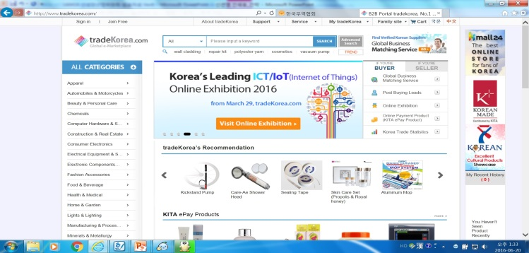
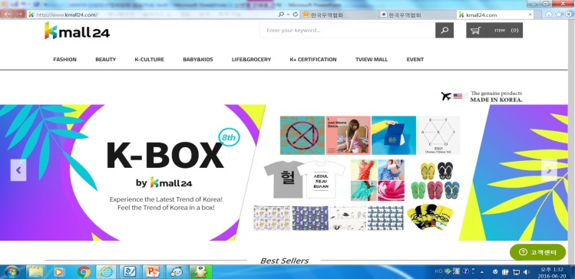
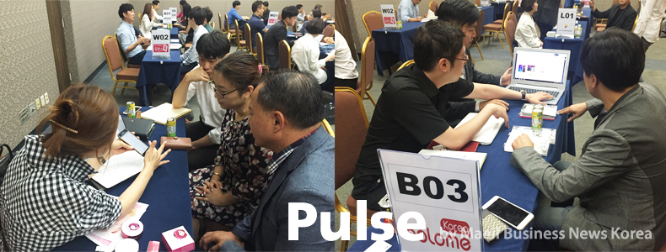
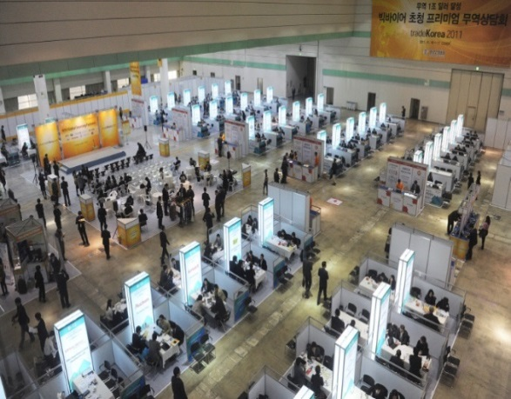
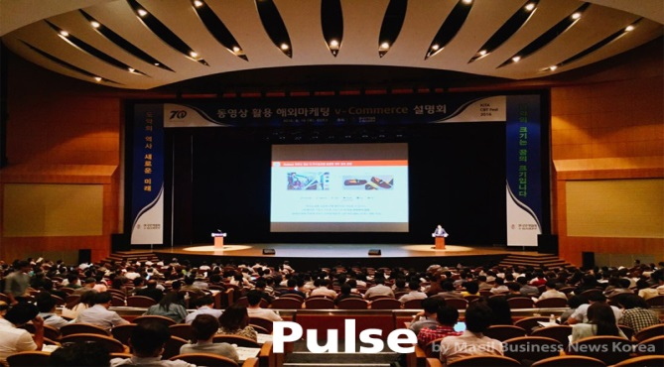
Omni Channel Marketing – On-line & Off-line
KITA
New vision of SMEs’ Cross-border e-Commerce
On-line : B2B, B2C, On-line Exhibitions, On-line Commercials, e-mail marketing, etc.
Off-line : 1:1 Business Meetings, Trade Shows, Seminars & Forums
B2B
B2C
1:1 Biz Meetings
Trade Shows
Seminars & Forums

Slide 6
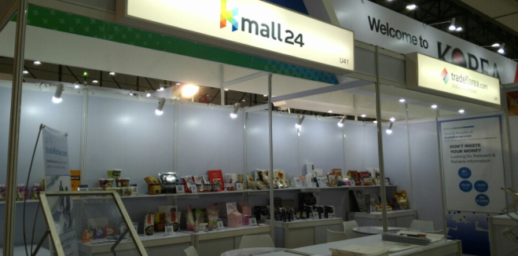
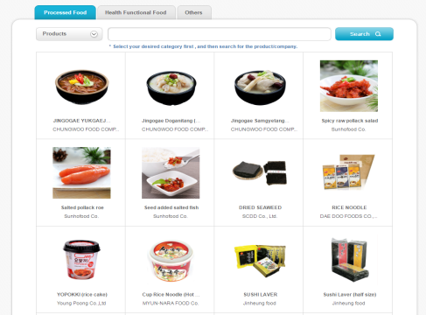
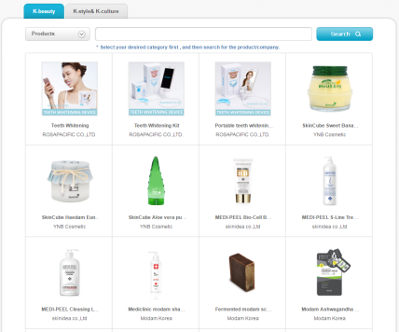
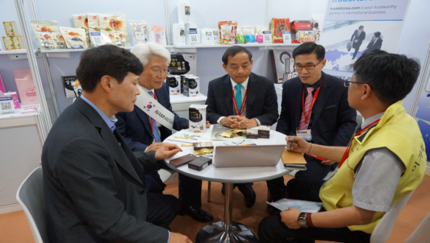
Omni Channel Marketing – O2O
KITA
New vision of SMEs’ Cross-border e-Commerce
Promoting goods online (tradekorea.com) prior to participating in exhibitions
Efficient & Time-saving Biz-matching : operated 75 online exhibitions since 2009
Online Marketing
Offline Marketing

Slide 7
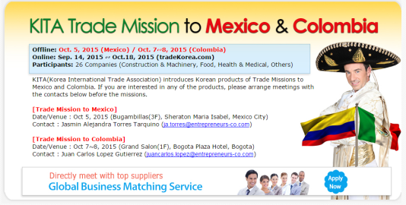
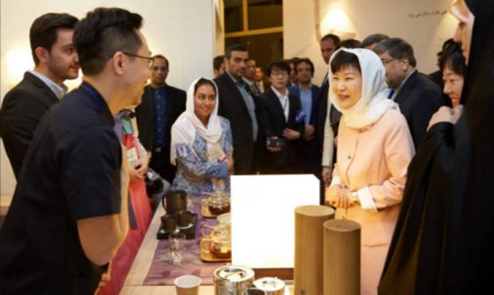
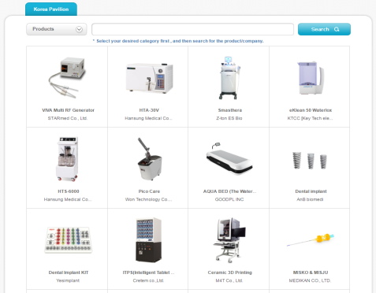
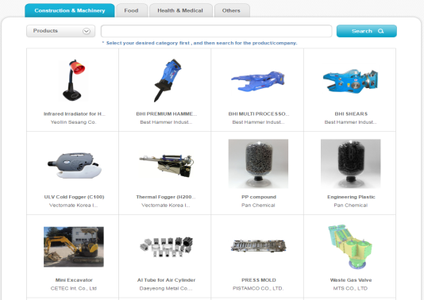
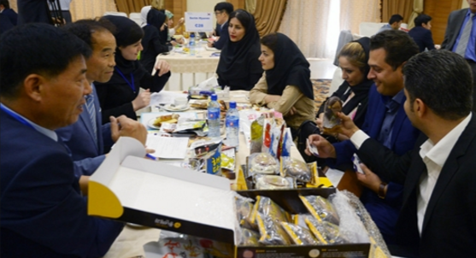
Omni Channel Marketing – O2O
KITA
New vision of SMEs’ Cross-border e-Commerce
Promoting goods online (tradekorea.com) prior to
participating economic diplomatic missions and organized 1:1 Business Meetings.
Efficient & Goal-oriented Biz-matching tool
Online Marketing
Offline Marketing
Showcase at VIP economic diplomacy
Korea-Iran 1:1
Biz matching event

Slide 8
Omni Channel Marketing – O2O
KITA
New vision of SMEs’ Cross-border e-Commerce
Usual Patterns of O2O
Multiple Convergence of the Above
- with Buyer A : B2B Portal + e-mails and phone calls + Off-line Meetings => Contract
- with Buyer B : Trade Shows + e-mails and phone calls + Off-line Meetings => Contract
- with Buyer C : B2C Portal + B2B Portal + e-mails + 1:1 Biz Meeting => Contract
….etc.
 | On-line to Off-line | Off-line to On-line
B2B Marketing | E-mails 1:1 Biz Meetings B2B Portals → Meet at Trade Shows | 1:1 Biz Meetings e-mails Trade Show Leads → Phone calls
B2C Marketing | See at Buy at On-line Store → Off-line Store [WEBROOMING] | See at Buy at Off-line Store → On-line Store [SHOWROOMING]

Slide 9
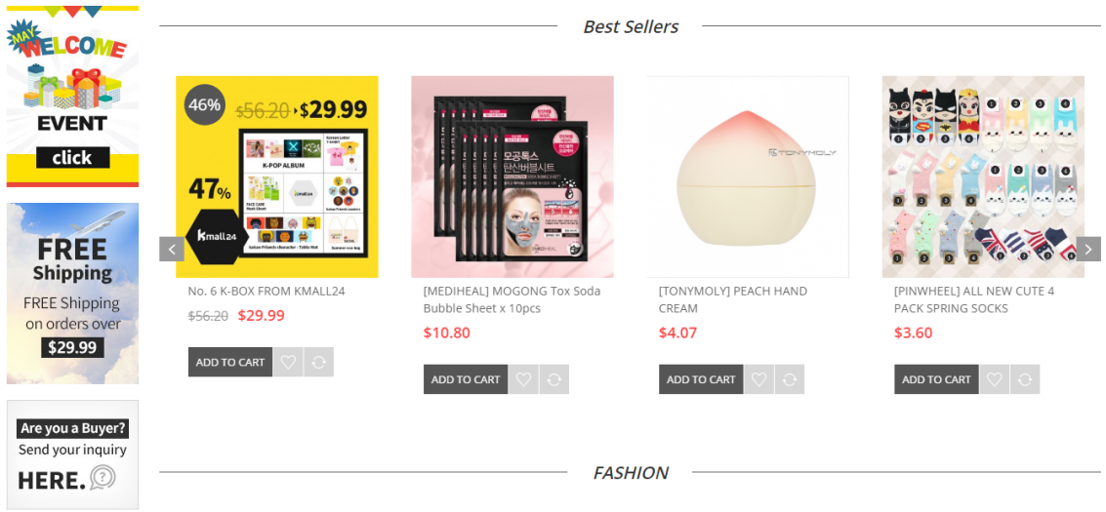
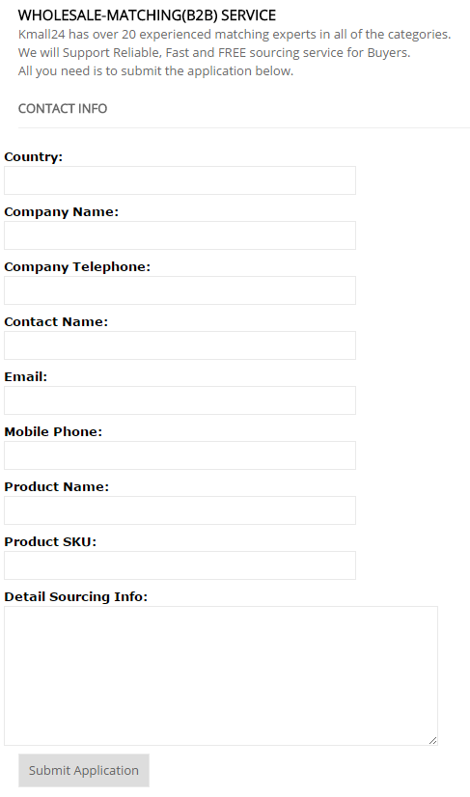
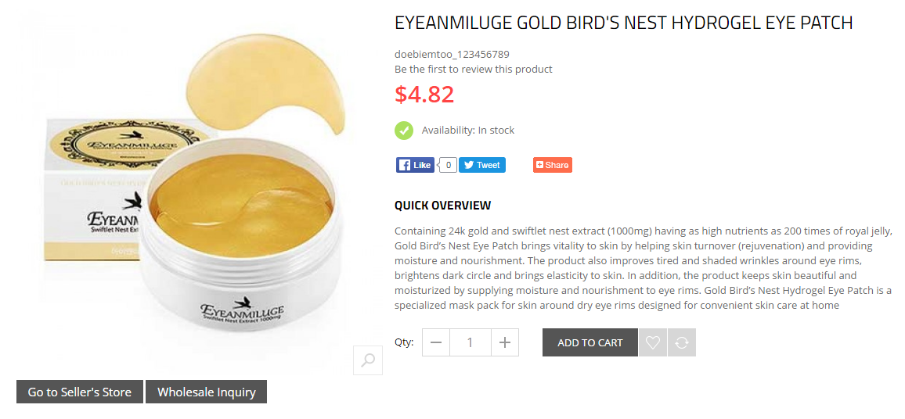
B2C + B2B = B2C2B
KITA
New vision of SMEs’ Cross-border e-Commerce
B2C + B2B
(B2C platform) attracts buyers to send “Wholesale Inquiry’ (B2C → B2B)
sellers to also sell at “tradeKorea.com” (B2C → B2B)
B2B request

Slide 10
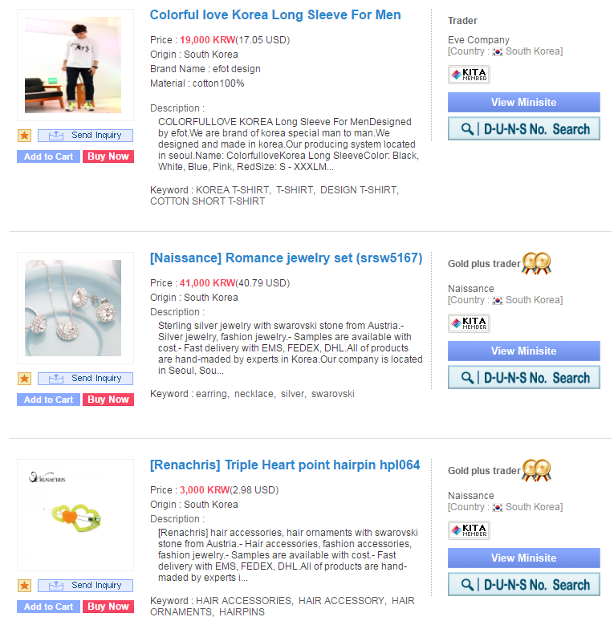
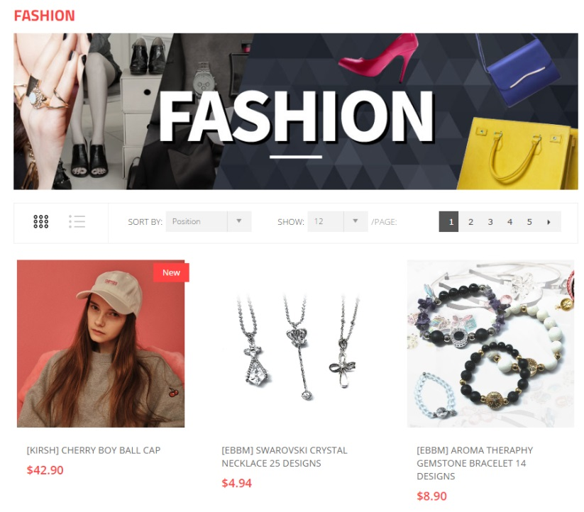
B2B + B2C = B2B2C
KITA
New vision of SMEs’ Cross-border e-Commerce
B2B + B2C
attracts buyers for consumer goods to buy interested goods at Kmall24(B2B → B2C)
attracts sellers of consumer goods to sell their goods at Kmall24(B2B → B2C)
consumer goods in B2B site
Selecting
DB
Marketing related products
in Kmall24

Slide 11
Upgrade CBEC quality and quantity by B2CB & B2BC
Shift marketing platform
Increase CBEC volume
6.0
(Million$)
B2C
B2B
B2B
B2C
⇒
2.0
0.3
‘14
‘15
‘16
KITA can do it both since we have both B2B and B2C platforms!
We are the only Korean SMEs supporting organization that have both B2B and B2C tools!

Slide 12
KITA
New vision of SMEs’ Cross-border e-Commerce
Table of Contents
■
Omni-Channel Marketing
On-line & Off-line => O2O
B2B & B2C => B2B2C & B2C2B
■
Smarter e-Marketing
Impact Visually
Interact Effectively
Target Accurately
Utilize Stars & Stories

Slide 13
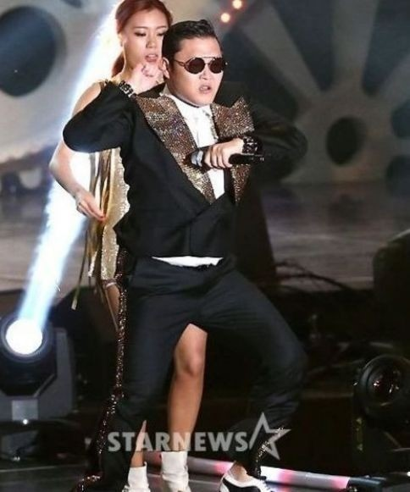
Smarter e-Marketing
KITA
New vision of SMEs’ Cross-border e-Commerce
1. IMPACT VISUALLY !
VIDEO COMMERCE : Video contents instead of texts and images !
- Video clips about the products can raise conversion rate upto over 5 times.
- Video clips take 57% of Korea’s mobile data traffic in 2015 -> Video contents’ influence
* Conversion Rate : the number of online customer visits that turn into actual orders
1 bil views on Youtube only in Korea,
made her every children’s big star and every parents’ enemy, only after 1.5 years, and the company is now the most powerful in Korea’s toy market.
Gmarket + Youtube Stars Collab => turnover increased30 times among young customers
2.5 bil views on Youtube
=> Became world star

Slide 14
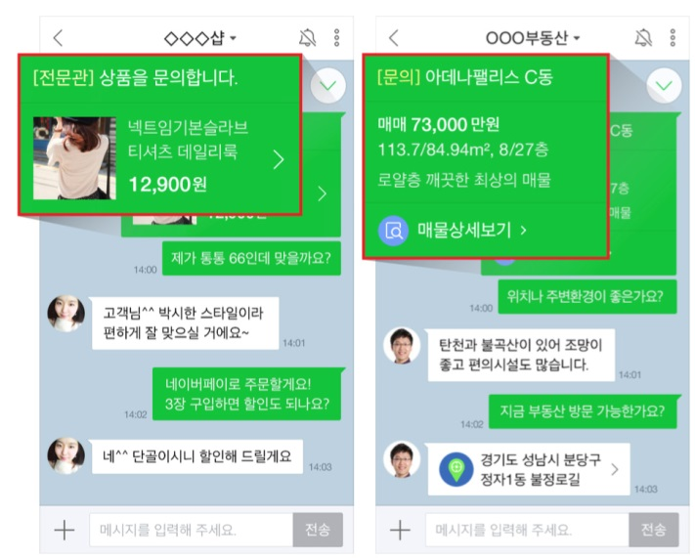
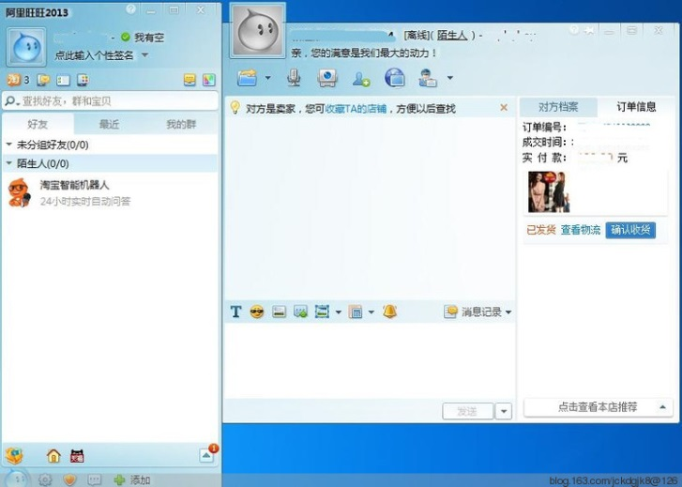
Smarter e-Marketing
KITA
New vision of SMEs’ Cross-border e-Commerce
2. Interact Effectively !
CONVERSATIONAL COMMERCE*
: Real-time communication with customers!
* Utilizing chat, messaging, or other natural language interfaces (i.e. voice) to interact with people,
brands, or services and bots, and the result is that we will be talking to brands and companies
over Facebook Messenger, WhatsApp, Telegram, etc.
Taobao’s Ali WangWang
A Naver Talk Talk’s “Talk manager” is helping a customer with shopping.

Slide 15
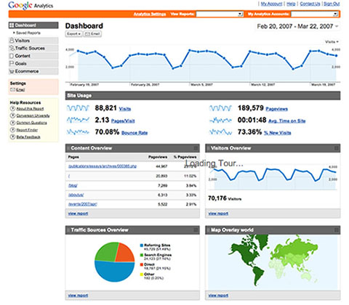
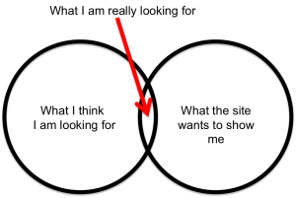
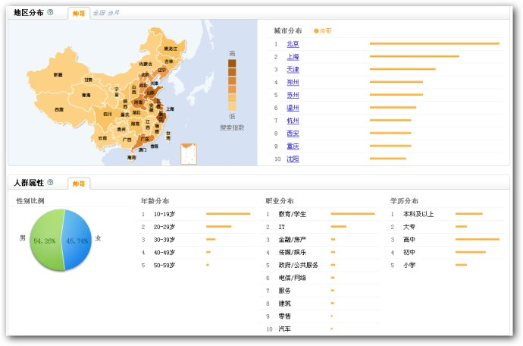
Smarter e-Marketing
KITA
New vision of SMEs’ Cross-border e-Commerce
3. Target Accurately !
CURATED COMMERCE *
: Recommend ‘the RIGHT’ product to ‘the RIGHT’ customer
- 45% of on-line shoppers are more likely to shop on a site that offers personalized recommendations.
* Creating unique product lines that provide customers with a distinct collection
not offered by other online retailers in a market.
Baidu Big Data
Google Analytics

Slide 16
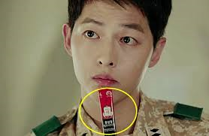
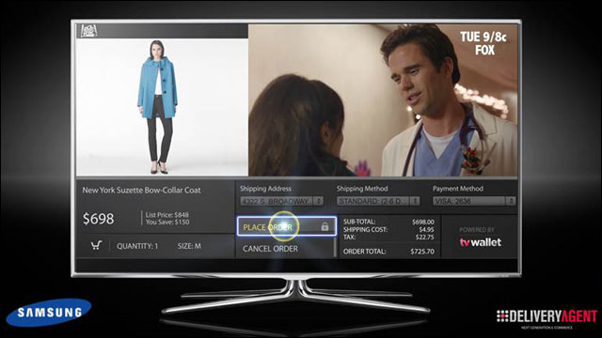
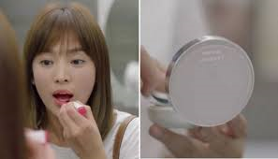
Smarter e-Marketing
KITA
New vision of SMEs’ Cross-border e-Commerce
4. Utilize Stars & Stories !
T COMMERCE *
: Shopping with the remote control while watching TV !
At least SMEs can get an idea from the latest marketing trends.

Slide 17
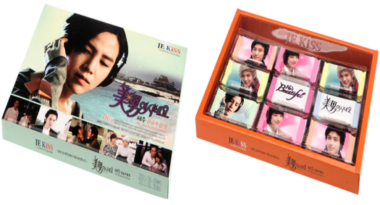
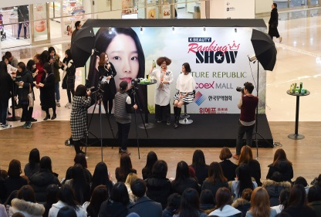
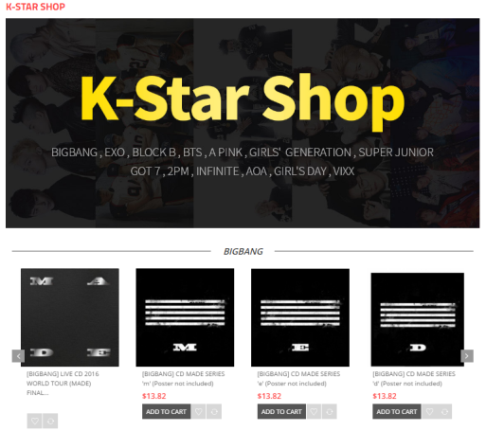
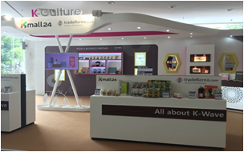
Smarter e-Marketing
KITA
New vision of SMEs’ Cross-border e-Commerce
K-Wave Marketing
Finding K-Concept goods/contents
+ online promotion
K-wave marketing Hub
Selling on B2C / B2B Platform
O2O Marketing on Mall & Exhibition

Slide 18
Next Commerce ?

Slide 19
Thank You
Cecilia Sun-Young SHIN
cecilia@kita.net

