Slide 1
The future of SMEs engagement in global trade in the era of cross-border ecommerce
5 May 2016, Jinjiang, Fujian Province, China
Mohammed Saeed,
Senior Trade Facilitation Adviser

Slide 2
SMEs from developing countries do not benefit from e-commerce opportunities
Global B2C e-commerce volume¹ ($ trillion)
Total online B2C e-commerce in Africa and Middle East is less than 2% of the world’s market and often limited to domestic platforms²
1. Source: McKinsey 2. Source: e-marketeer

Slide 3
SMEs current e-commercialization approach: “My sister lives in Paris”
Using an acquaintance as a front office...
…on the edge of legality
Open payment solution and site listing
Consignment not properly declared at the customs
Undeclared cash flows back to origin country
No sustainable framework to manage growth
High risk for reputation and legality

Slide 4
SMEs current e-commercialization approach: the “Angry Bird”
“Firing” products
to destination market…
…without a full understanding of cross-border transactions requirements
VAT
De Minimis
CUSTOMS
Penalty
Return
Shipping

Slide 5
SMEs in developing countries face obstacles along the e-commerce value chain
Visibility
SMEs from developing countries are excluded from major e-platforms
Payments
SMEs in developing countries can seldom offer simple and cheap payment solutions to their clients
Logistics
SMEs consignments often translate into disproportionately high logistics costs and face complex border requirements
Aftersales
SMEs fail to provide sufficient information for making inform choice and display burdensome return / refund policies

Slide 6
How ITC helps SMEs overcome these obstacles: the Morocco Case Study

Slide 7
“Made in Morocco”
400
SMEs joined an Economic Interest Group in Morocco where they own shares in the common institution
3
Legal entities have been established in EU, US and Middle East to transact on behalf of Moroccan parent C^{ie}
1
E-commerce platform was established to promote and sell products (incl. e-payment mechanisms)
400,000
Stock keeping units registered and available under the “Made in Morocco” e-platforms
800,000
Visitors on the “Made in Morocco” e-platform

Slide 8
ITC ‘e-Solution program’ used in Morocco to establish online business
eMall
Online market place enabling shared access and operating costs to payment solutions, logistics and marketing. From the eMall products can be re-listed on major sites, all from one place
eTrust
Internationally recognized qualified digital signature and SSL certificates for SMEs. National framework for eSignature.

Slide 9
ITC ‘e-Solution program’ used in Morocco to facilitate international payments
ePayment
Payment modules ready to integrate into e-commerce sites and market places. Compliance with financial regulations.
eTradePermit
Representation services ensuring conformity with legal and fiscal requirements in markets such as the EU, USA and Japan.

Slide 10
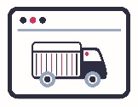
ITC ‘e-Solution program’ used in Morocco to
…Improve cross-border deliveries
eLogistics
Access to cost effective outbound logistics, storage and management of goods delivery within target markets and returns management.
…Enhance aftersales mechanisms
eCRM
Cloud-based solutions and support for sales and customer service to the standards expected by international customers.

Slide 11
Key processes to be considered to improve e-commerce value chains
Establishing online business
1
2
Facilitating international payments
3
Improving cross-border deliveries
4
Enhancing aftersales mechanisms

Slide 12
4 processes should be addressed at three levels of the economy
Three layers of determinants
Firm level capabilities
e.g. business, language, warehousing, packaging skills, bank account and online banking
Immediate business environment
TISIs, networks, infrastructure, platforms, access to postal / express delivery services
National policy environment
e.g. Simple business registration, implementation of e-signatures and e-contracts laws
Bringing SME voice into rule making
Raise understanding
Build capacity
Build consensus
Make change happen

Slide 13
The B2C2B strategy
B2C offers considerably higher margin than B2B
Retailers earn up to 50% margin on sales
Commodity producers share in less than 5% of end consumer price
However B2B markets are vastly bigger and can be easier to manage by SMEs
Customer willing to handle import / export operation
Flexibility on payment modalities
SMEs should then use B2C trade as a marketing investment to build strength in B2B markets
By demonstrating demand at higher prices and building brand presence in destination markets through B2C, SMEs are better positioned to negotiate with international buyers

Slide 14
Don’t wait for the market, reach out to customers in destination countries!

Slide 15
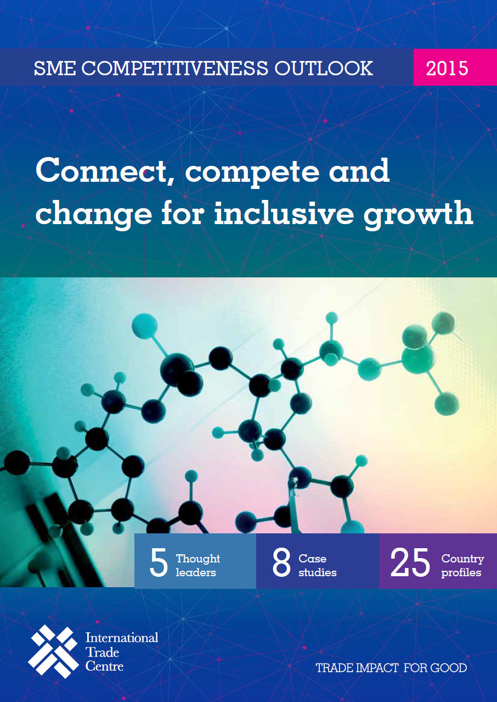
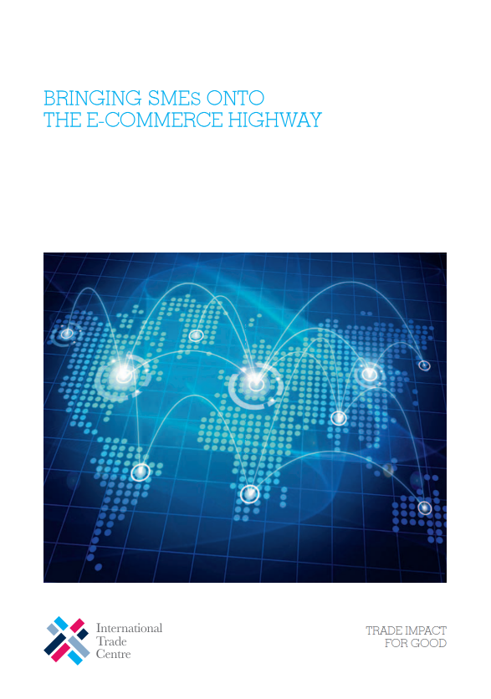
ITC publications on SMEs and e-commerce

Slide 16
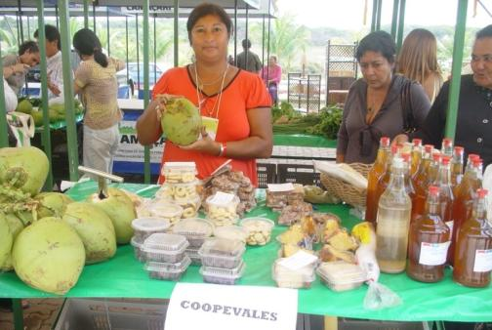
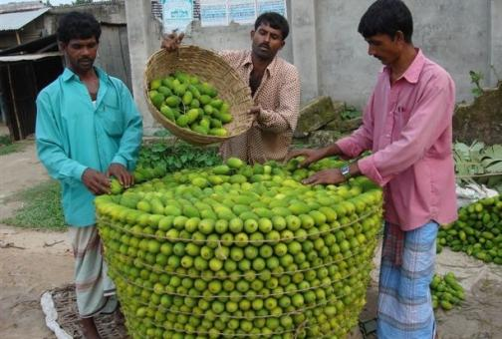
Thank you for your attention

